Slide 1
Three years into the GSR: findings summarized
Lucy Huang and Bo Peng

Slide 2
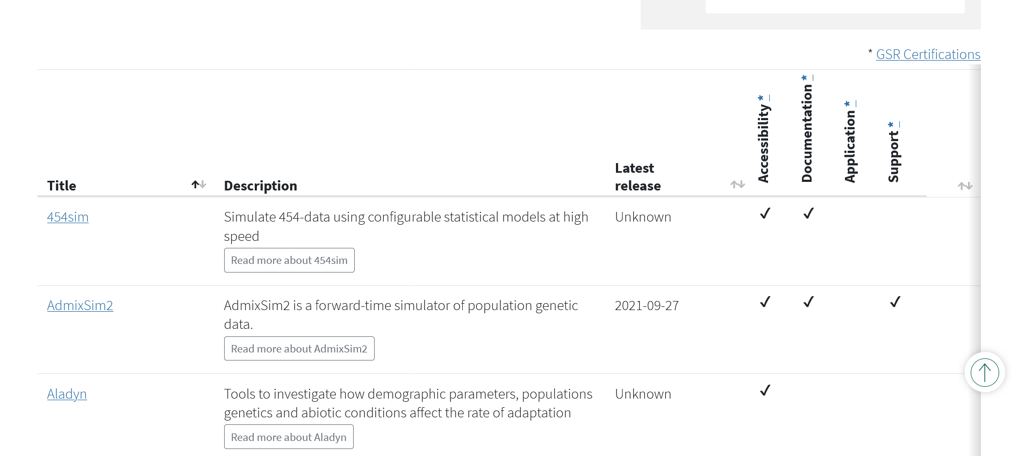
What is the GSR?
Genetic Simulation Resources (c. 2013)
GSR Certification (c. 2018)
Aids investigators in finding suitable simulation tools
Promotes higher standards in usability, scientific application, user support, etc.

Slide 3
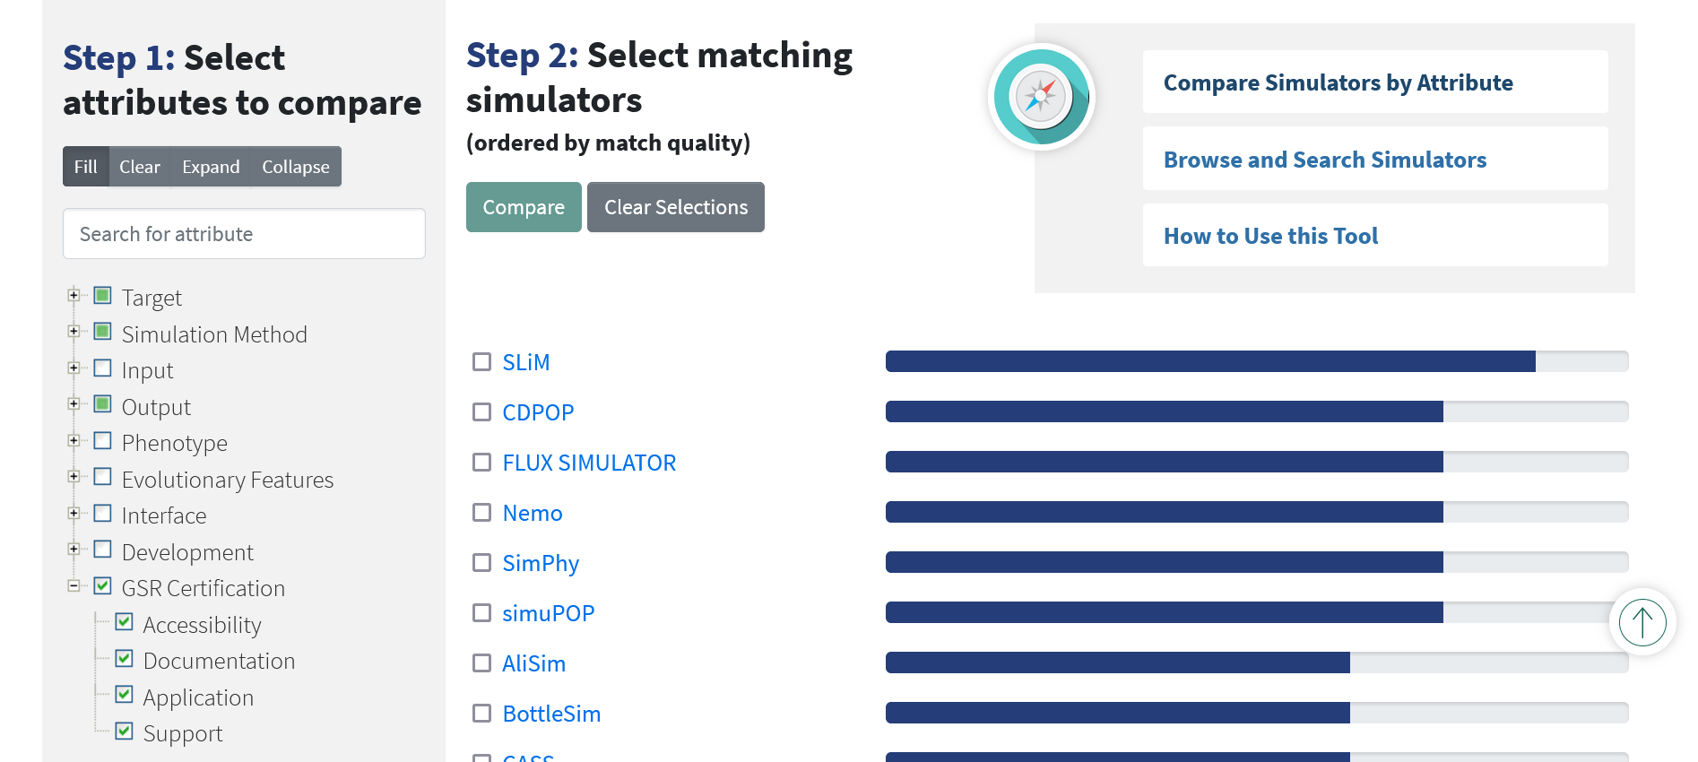

Slide 4
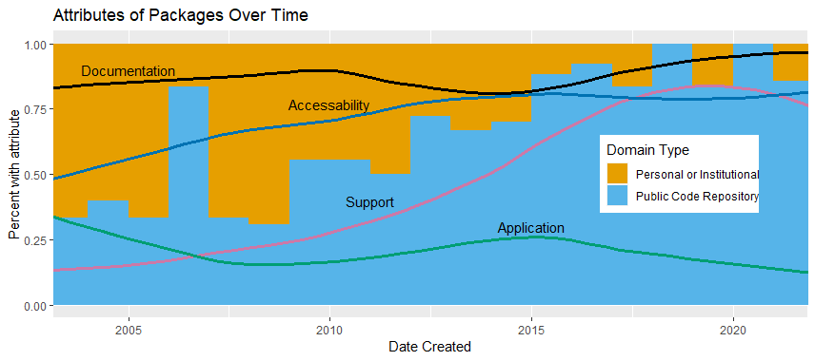
Then and now
Preliminary accessibility results, certifications to be updated

Slide 5
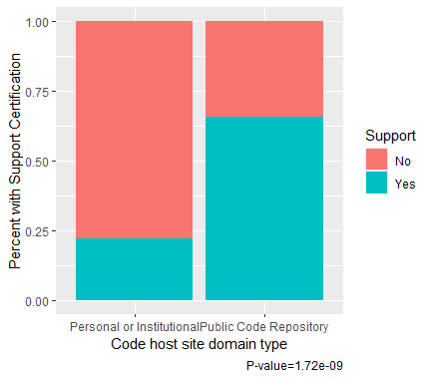
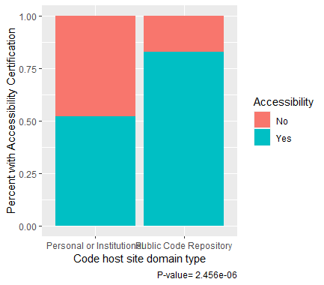

Slide 6
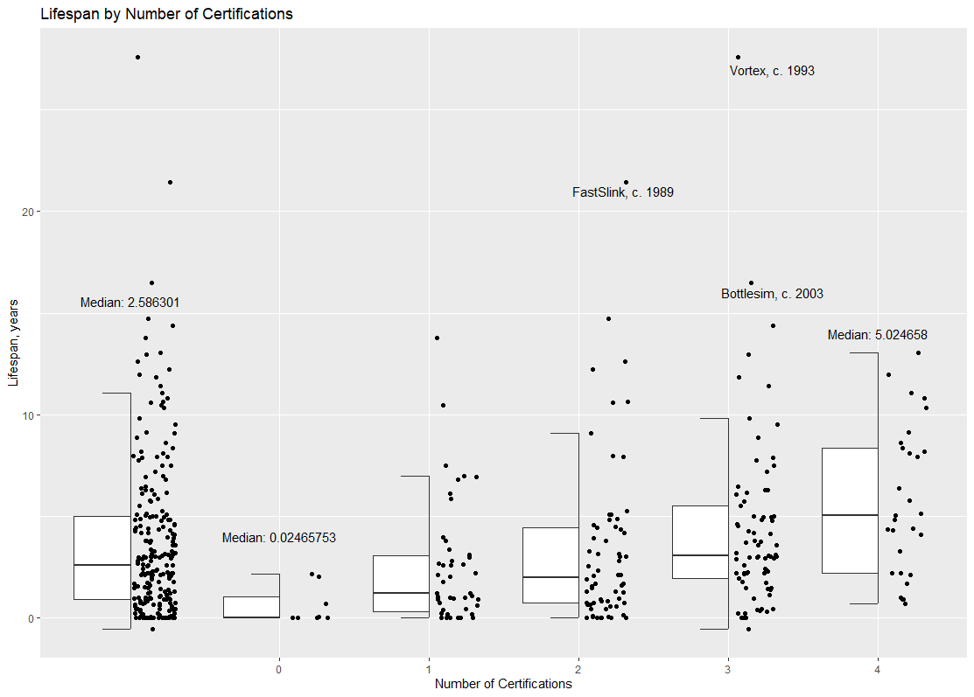

Slide 7
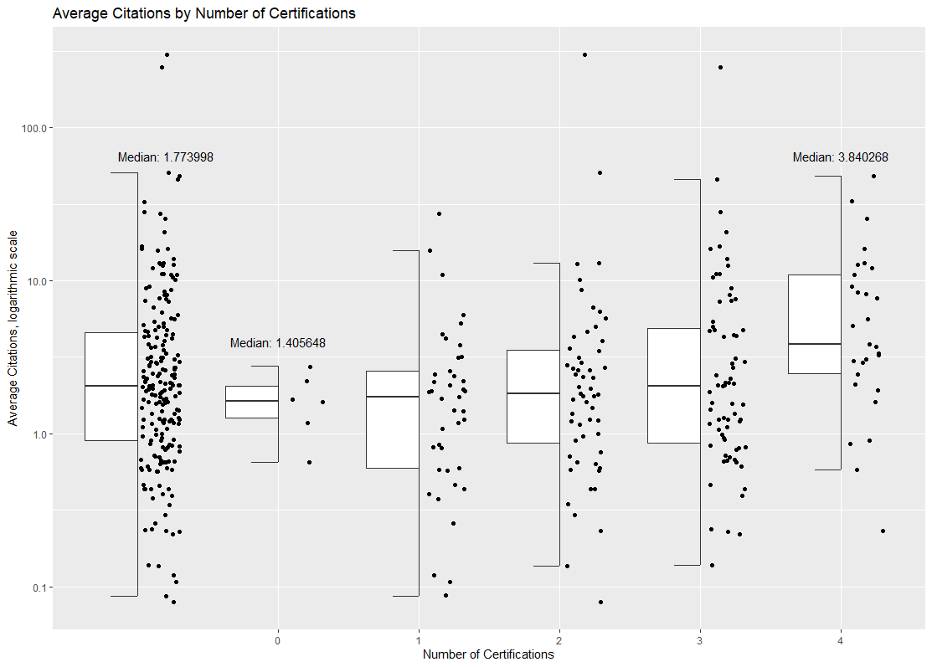

Slide 8
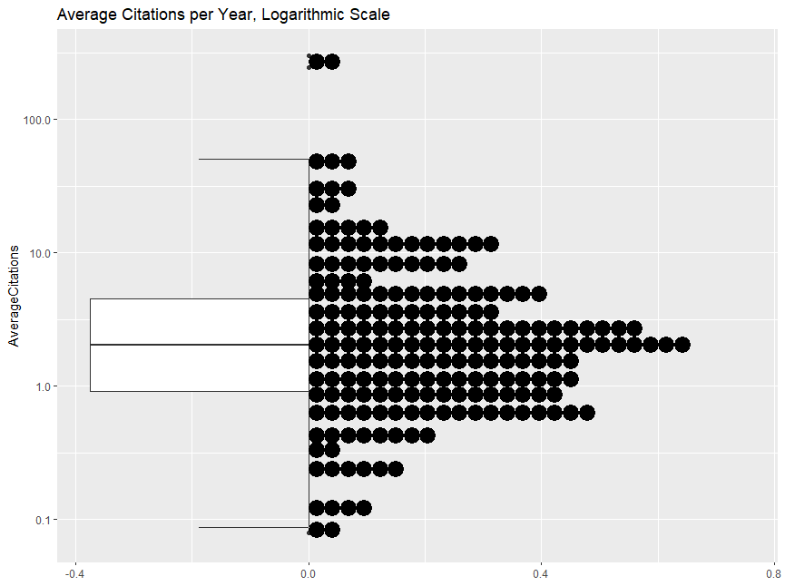
Median:1.773998

Slide 9
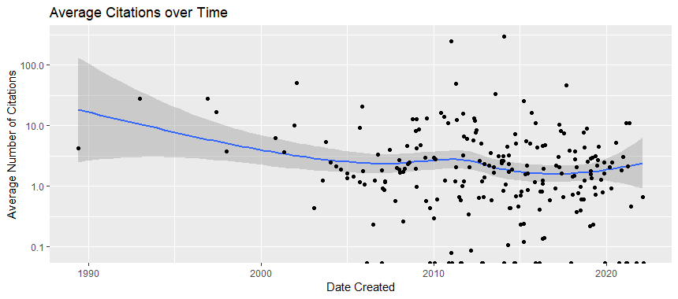

Slide 10
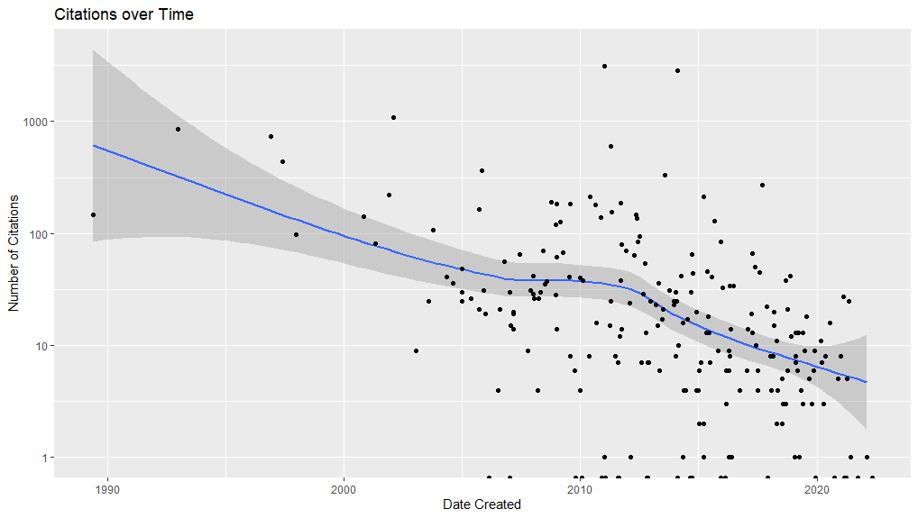

Slide 11
